Slide 1
GSBA 511: Managerial Economics
Prof. Akbulut
Chapters 4 and 9.4

Slide 2
Outline
Consumer Surplus and Producer Surplus
The Efficiency of Competitive Markets
Government Intervention on the Market:
Price Floors
Price Ceilings
Taxes & Subsidies
Tariffs & Quotas

Slide 3
Consumer and Producer Surplus
P
Consumer surplus = area of blue triangle = ½($5)(5) = $12.5
$10
9
8
7
6
5
4
3
2
1
S
Producer surplus = area of orange triangle = ½($5)(5) = $12.5
CS
PS
Economic Surplus = Total Surplus = PS + CS is maximized at market equilibrium → Market Efficiency,
Economic Efficiency
D
Q
0 1 2 3 4 5 6 7 8

Slide 4
Effects of Government Intervention – Price Controls
2 types of price controls:
Price ceiling – A legally established maximum price a seller can charge
Price floor – A legally established minimum price a seller can be paid

Slide 5
Changes in Consumer and Producer Surplus from Price Floors
deadweight loss Net loss of total (consumer plus producer) surplus.
Price
Deadweight Loss
Lost Consumer Surplus
S
New Consumer Surplus
P_{H}
P_{o}
Lost Producer Surplus
New Producer Surplus
D
Q_{L}
Q_{o}
Quantity

Slide 6
Changes in Consumer and Producer Surplus from Price Ceilings
Price
Deadweight Loss
Lost Consumer Surplus
S
New Consumer Surplus
P_{o}
Lost Producer Surplus
P_{L}
New Producer Surplus
D
Q_{L}
Q_{o}
Quantity

Slide 7
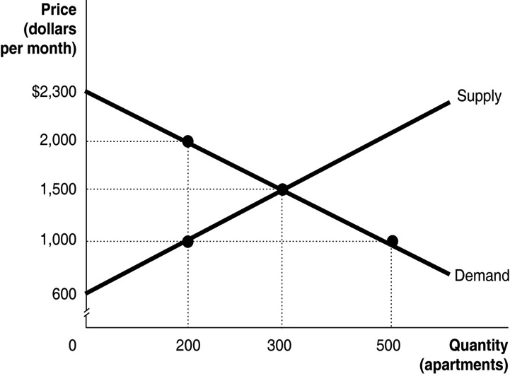
Active Learning Welfare Consequences of Rent Ceiling
The figure shows the market for apartments in Springfield. Recently, the government imposed a rent ceiling of $1,000 per month. What is the value of the deadweight loss after the imposition of the ceiling?
$50,000
$125,000
$175,000
$260,000

Slide 8
The Impact of a Tax
specific tax: Tax of a certain amount of money per unit sold.
S_{Tax}
Price
Tax
S
New Consumer Surplus
Lost Consumer Surplus
Deadweight Loss
P_{B}
Tax Revenues
P_{o}
Lost Producer Surplus
P_{S}
New Producer Surplus
D
Q_{L}
Q_{o}
Quantity

Slide 9
The Impact of a Subsidy
subsidy Payment reducing the buyer’s price below the seller’s price;
i.e., a negative tax.
Price
Gain in Producer Surplus
S
New Consumer Surplus
P_{S}
S_{Sub}
Subsidy
Gain in Consumer Surplus
P_{o}
P_{D}
Deadweight Loss
New Producer Surplus
Subsidy Cost
D
Q_{o}
Q_{H}
Quantity

Slide 10
Gains from International Trade
Without trade:
domestic price = P₁
domestic quantity = Q₁
CS = ?
PS= ?
With free trade:
domestic price falls to P_{W}
Imports = ?
CS = ?
PS = ?
Net Gain from Trade =
P
P
imports
S_{dom}
S_{row}
a
P₁
b
d
P_{W}
c
D_{dom}
D_{row}
Q
Q₂
Q₁
Q₃
Q
Domestic Market
Rest-of-World Market

Slide 11
Protective Tariffs
S_{dom}
P
a
P₁
P
b
c
d
P_{W} + t
e
f
g
h
i
tariff, t,
per unit
P_{W}
j
D_{dom}
Q₂
Q’₃
Q
Q’₂
Q₁
Q₃
Imports after tariff

Slide 12
Protective Quotas
P
a
S_{dom}
P₁
P
b
c
d
P_{W} + t
e
f
g
h
i
price will rise to equate demand to quota plus domestic production Q’₂.
P_{W}
j
D_{dom}
Q₂
Q’₃
Q
Q’₂
Q₁
Q₃
Import quota

